Slide 1

TVE Group of Companies

Slide 2



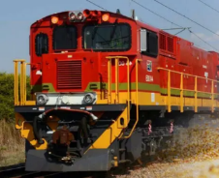

ACHIEVE A
MILLION TONS WITH OUR MOTOR
UNDERGROUND
OPEN PIT
RAIL
INDUSTRIAL
TVE Group of Companies
CONTACT US
Tel: 011 493 8449
E-mail: sales@tvemotors.com
Web: www.tvemotors.com
Address: 4 Simmonds Street, Selby South, Johannesburg

Slide 3
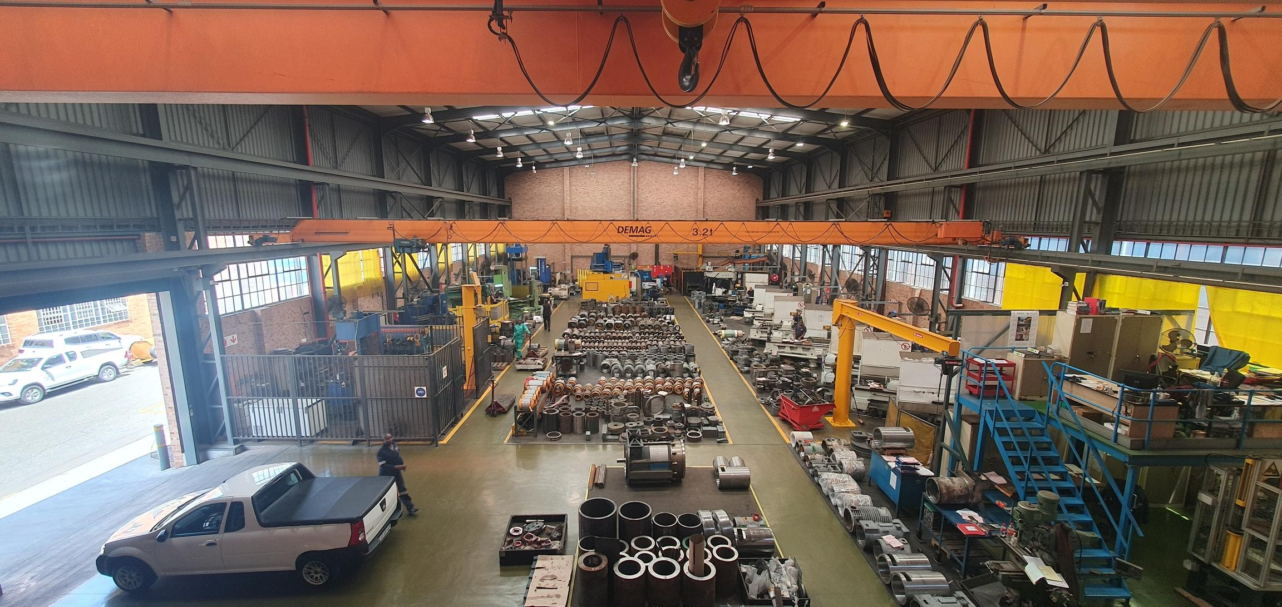
ACHIEVE A
MILLION TONS WITH OUR MOTOR
WORLD CLASS MACHINING CAPABILITY
TVE Group of Companies
CONTACT US
Tel: 011 493 8449
E-mail: sales@tvemotors.com
Web: www.tvemotors.com
Address: 4 Simmonds Street, Selby South, Johannesburg

Slide 4
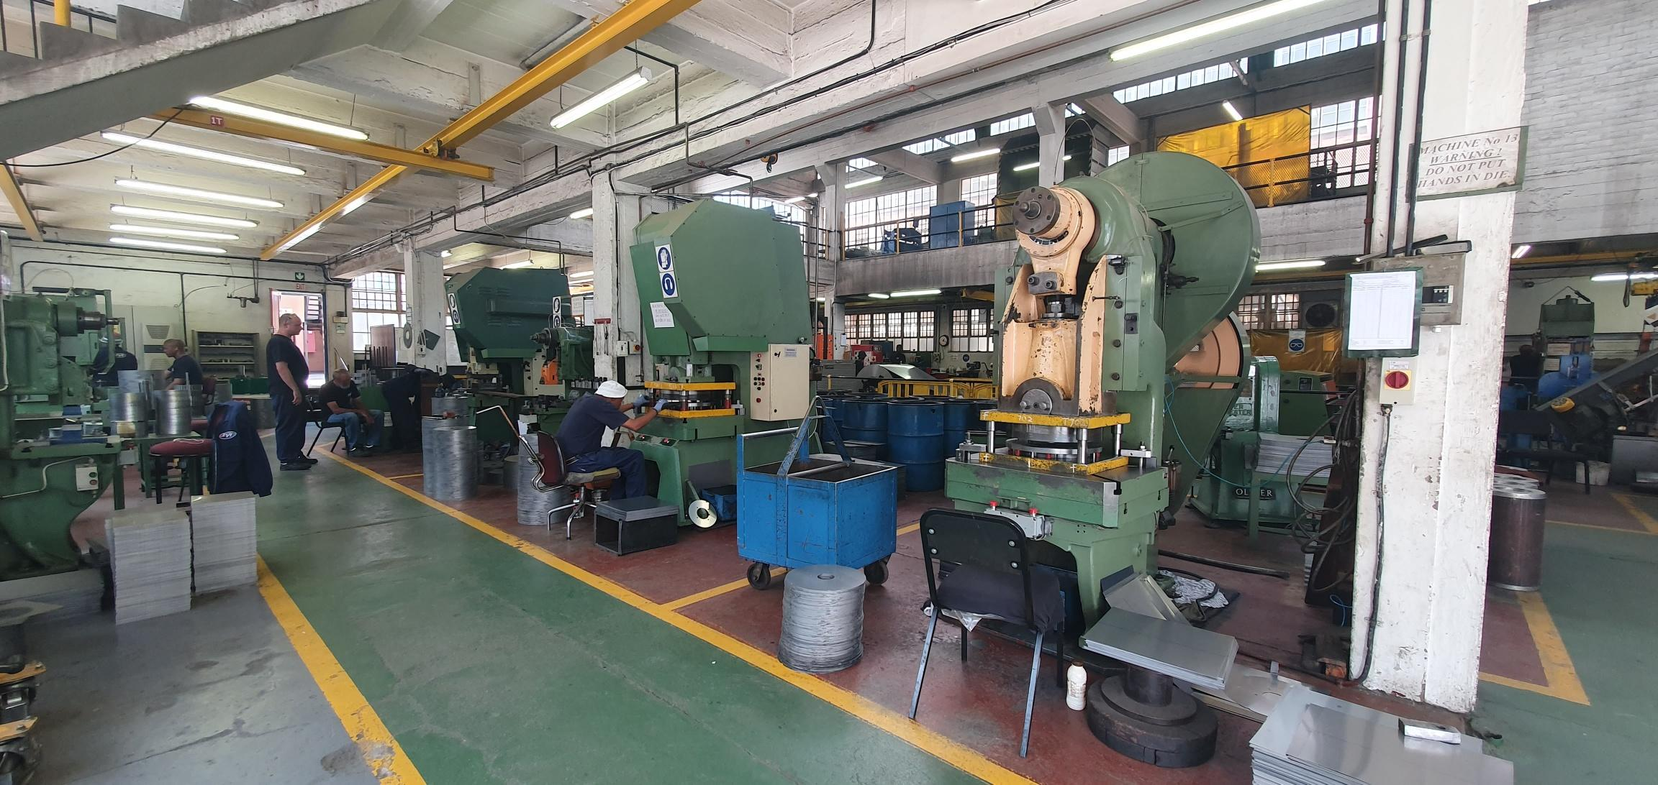
ACHIEVE A
MILLION TONS WITH OUR MOTOR
STATOR AND ROTOR CORE MANUFACTURING PLANT
TVE Group of Companies
CONTACT US
Tel: 011 493 8449
E-mail: sales@tvemotors.com
Web: www.tvemotors.com
Address: 4 Simmonds Street, Selby South, Johannesburg

Slide 5
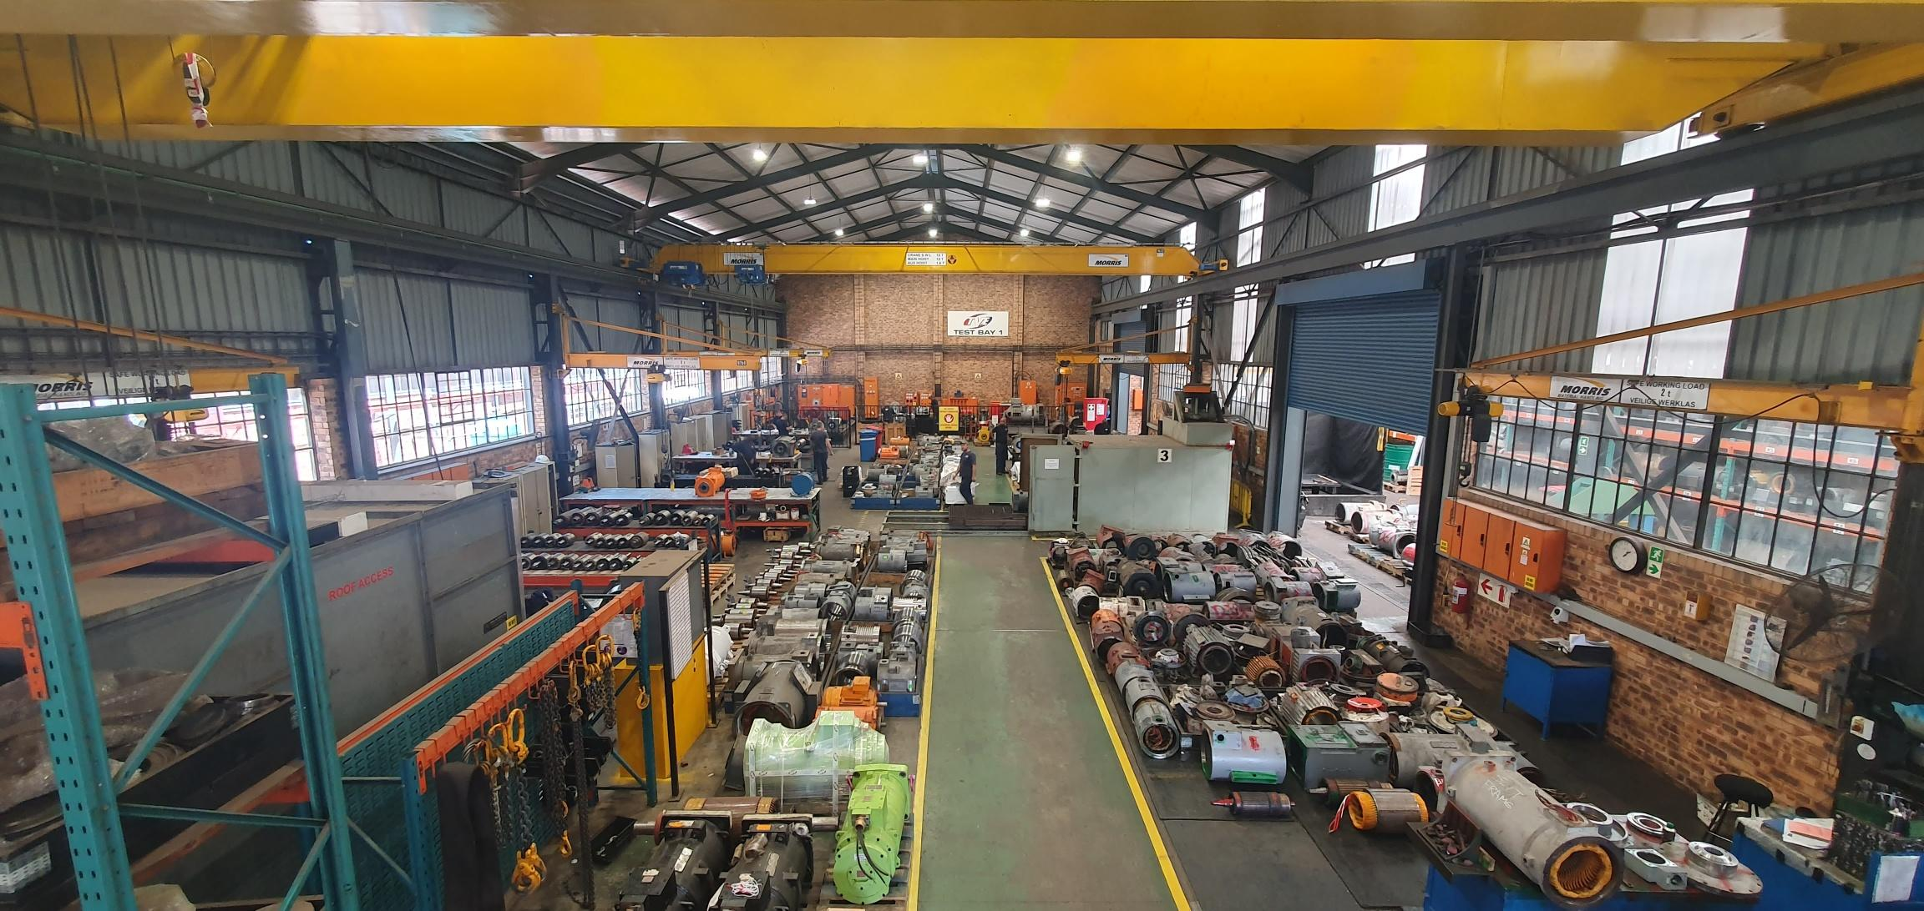
ACHIEVE A
MILLION TONS WITH OUR MOTOR
SPECIALIST FLAMEPROOF ASSEMBLY
TVE Group of Companies
CONTACT US
Tel: 011 493 8449
E-mail: sales@tvemotors.com
Web: www.tvemotors.com
Address: 4 Simmonds Street, Selby South, Johannesburg

Slide 6
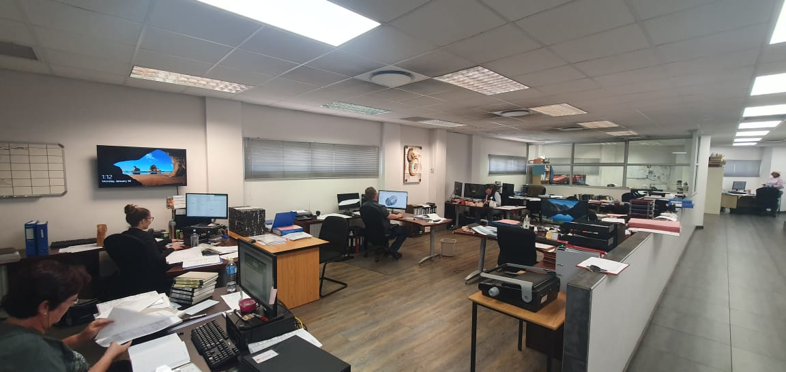
ACHIEVE A
MILLION TONS WITH OUR MOTOR
CONTINUOUS DESIGN AND DEVELOPMENT WITH EXPERIENCED ENGINEERING DEPARTMENT
TVE Group of Companies
CONTACT US
Tel: 011 493 8449
E-mail: sales@tvemotors.com
Web: www.tvemotors.com
Address: 4 Simmonds Street, Selby South, Johannesburg

Slide 7
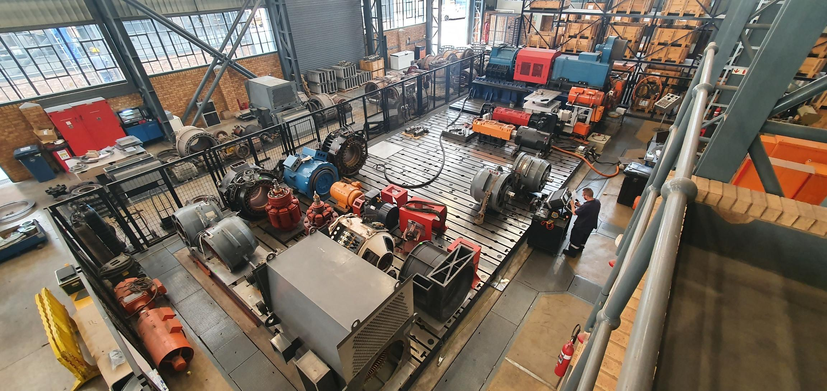
ACHIEVE A
MILLION TONS WITH OUR MOTOR
FULL LOAD TESTING
TVE Group of Companies
CONTACT US
Tel: 011 493 8449
E-mail: sales@tvemotors.com
Web: www.tvemotors.com
Address: 4 Simmonds Street, Selby South, Johannesburg

Slide 8
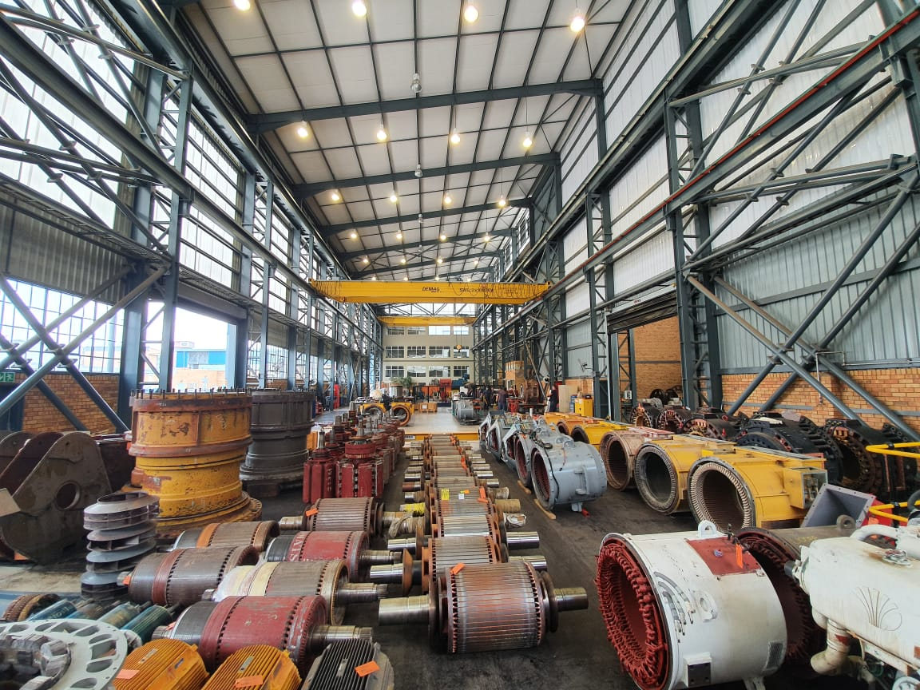
ACHIEVE A
MILLION TONS WITH OUR MOTOR
OPEN PIT MINING
TVE Group of Companies
CONTACT US
Tel: 011 493 8449
E-mail: sales@tvemotors.com
Web: www.tvemotors.com
Address: 4 Simmonds Street, Selby South, Johannesburg

Slide 9
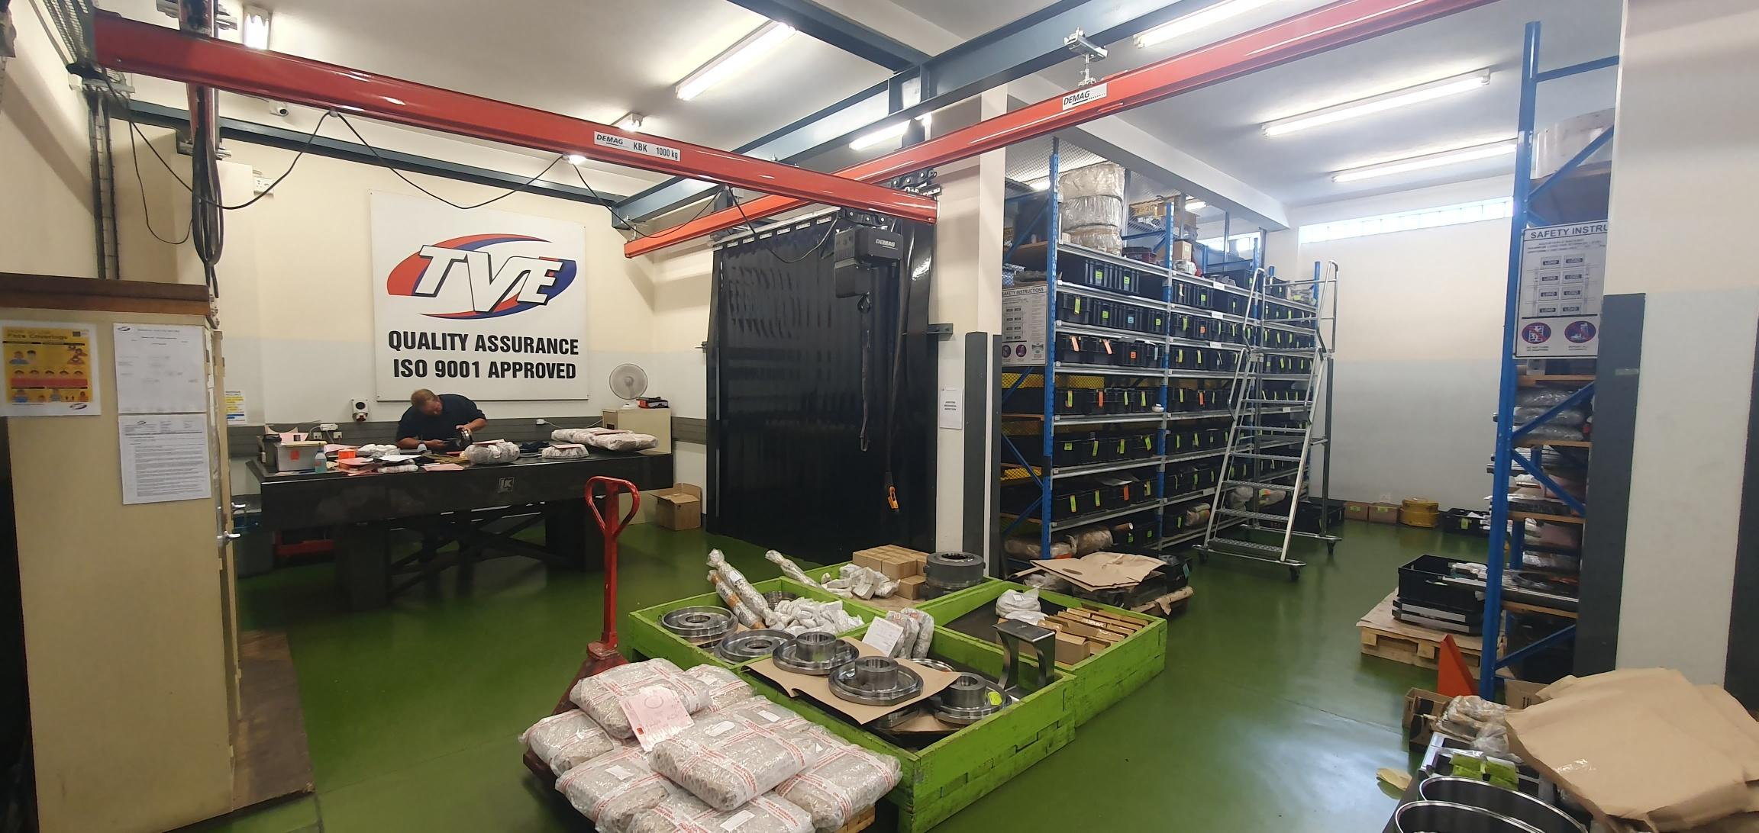
ACHIEVE A
MILLION TONS WITH OUR MOTOR
ISO ACCREDITATION : 9001
TVE Group of Companies
CONTACT US
Tel: 011 493 8449
E-mail: sales@tvemotors.com
Web: www.tvemotors.com
Address: 4 Simmonds Street, Selby South, Johannesburg

Slide 10
ACHIEVE A
MILLION TONS WITH OUR MOTOR
MINING EQUIPMENT
TVE Group of Companies
CONTACT US
Tel: 011 493 8449
E-mail: sales@tvemotors.com
Web: www.tvemotors.com
Address: 4 Simmonds Street, Selby South, Johannesburg

Slide 11
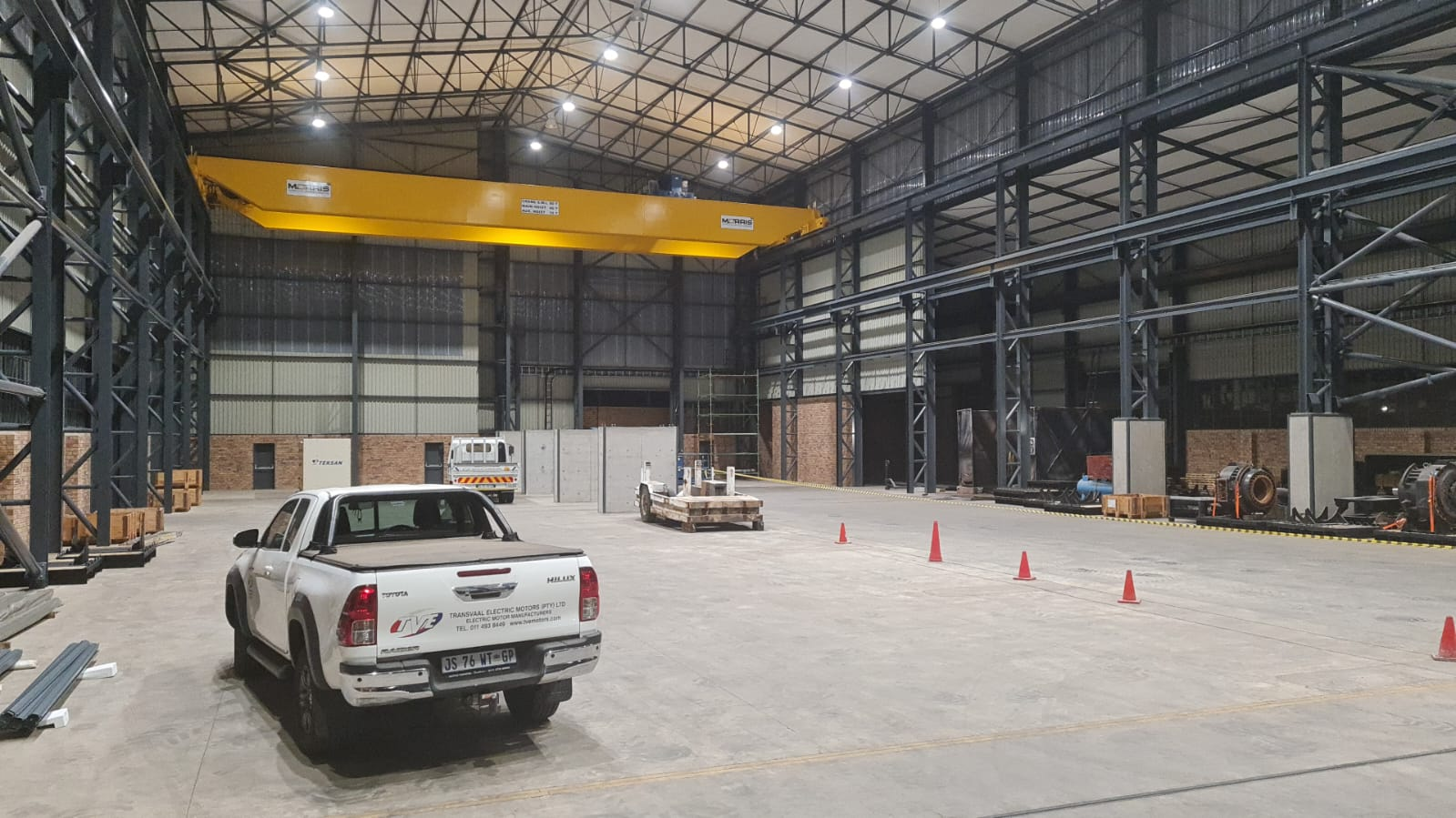
ACHIEVE A
MILLION TONS WITH OUR MOTOR
INVESTMENT
TVE Group of Companies
CONTACT US
Tel: 011 493 8449
E-mail: sales@tvemotors.com
Web: www.tvemotors.com
Address: 4 Simmonds Street, Selby South, Johannesburg

Slide 12


UNDERGROUND MINING
OPEN PIT MINING
EXPORTS
TVE Group of Companies

Slide 13
TVE Group of Companies

